Slide 1
C#

Slide 2

C#
.NET Programming language
Strongly typed
Object-Oriented
Open source
Simple, modern and flexible
~ Java

Slide 3
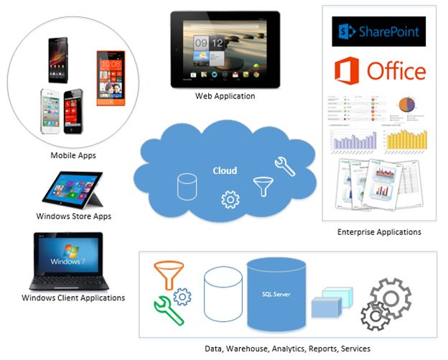
What can C# do for you?
Windows client applications (Windows Forms & WPF)
Windows libraries and components
Windows services
Web applications (ASP.NET)
Web services (WCF) and Web API
UWP Apps (Universal Windows Platform)
Native iOS and Android mobile apps (Xamarin)
Backend services
Azure cloud applications and services
Backend database using ML/Data tools
Interoperability software such as Office, SharePoint, SQL Server, …
Artificial Intelligence and Machine learning
Blockchains and distributed ledger technology including cryptocurrency
Internet of Things (IoT) devices
Gaming consoles and gaming systems
Video games
…
https://www.c-sharpcorner.com/UploadFile/mahesh/what-can-C-Sharp-do-for-you/

Slide 4
C# @ Thomas More?
Formerly the main (first) programming language
Replaced with Python
.NET Development
Focus on Web & Advanced Programming Techniques
ASP.NET MVC + API & Unit Testing, DI, Repository, UoW

Slide 5
C# Crash Course

Slide 6
Syntax
Curly braces { } mark the beginning and the end of a block of code
Every C# statement ends with a semicolon ;
Comments
// This is a comment in one line
/* This is a comment
over multiple lines */

Slide 7
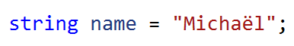
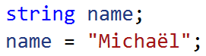
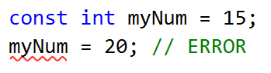
Variables - declaration
Why an error?

Slide 8
Data types
C# | Description | Example (declaration)
object | Base class for all data types (each data type is an object) | object object1 = "Test"; object object2 = 12;
int | Whole number | int myNum = 5;
long | Whole number (longer range) | long myLongNum = 78787877887877L;
float | Fractional number (6 to 7 decimal digits | float myFloatNum = 5.99f;
double | Fractional number (max 15 decimal digits) | double myDoubleNum = 4.189281891;
bool | True or false | bool myBool = true;
char | Single character/letter (single quotes) | char myLetter = ‘M’;
string | Sequence of characters (double quotes) | string myText = “Hello World”;

Slide 9
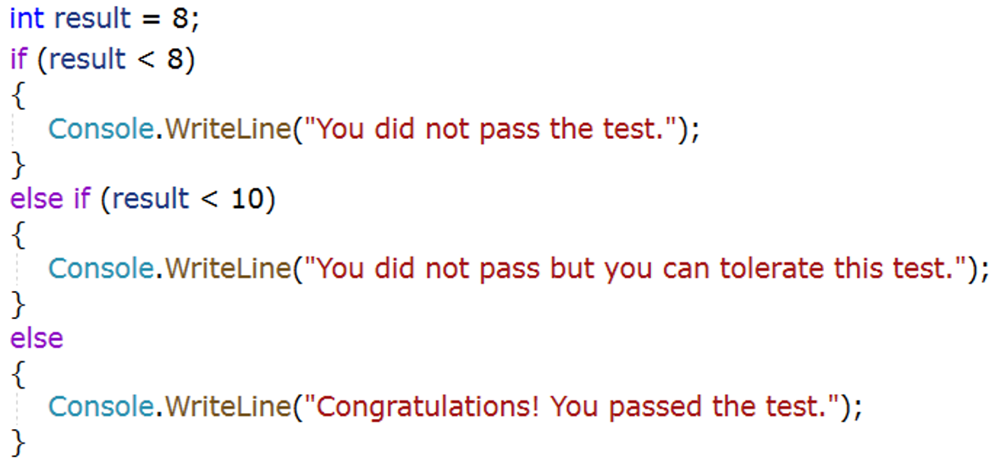
if ... else

Slide 10
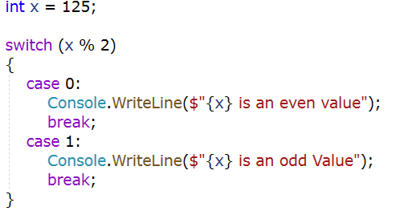
switch

Slide 11
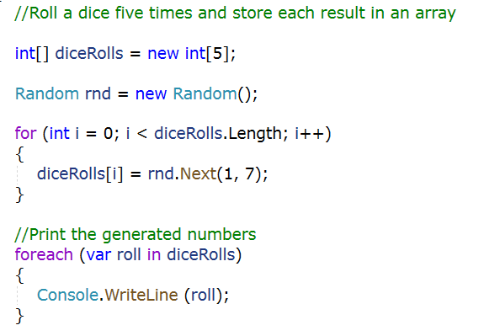
for & foreach

Slide 12
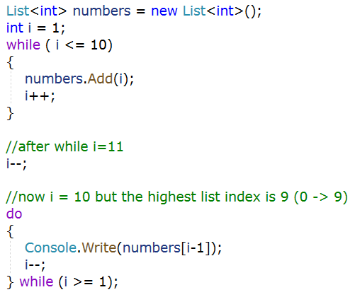
while & do ... while

Slide 13
Object-Oriented Programming
OOP
Class (Car): blueprint for creating objects
attributes (brand, type, color)
methods (drive, brake)
Objects: instantiated from a class
Citroën, C8, blue

Slide 14
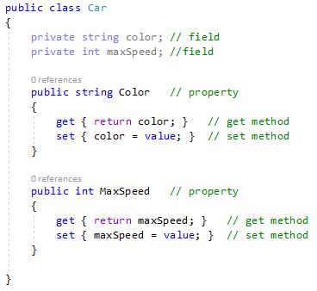
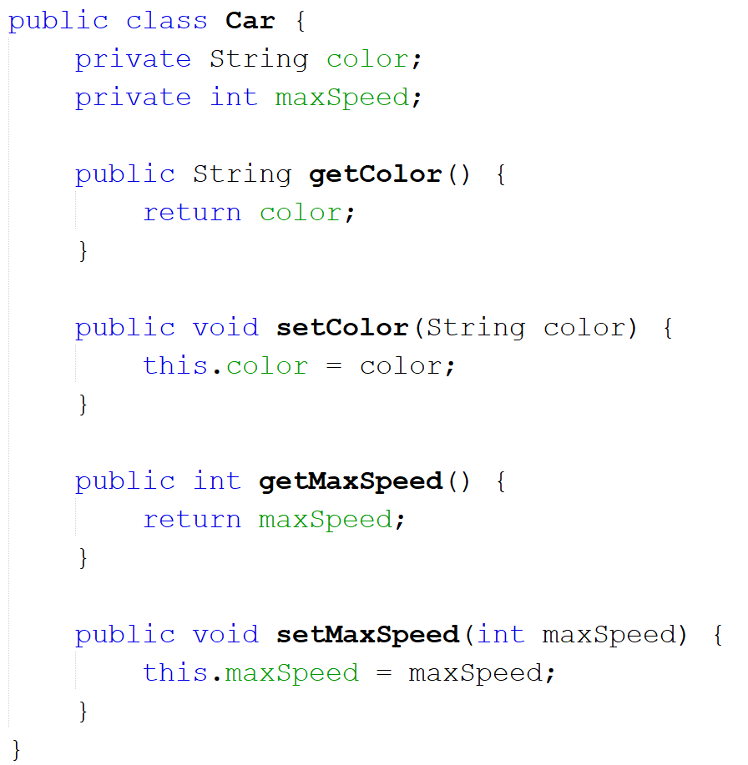
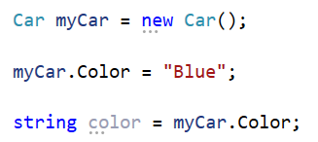
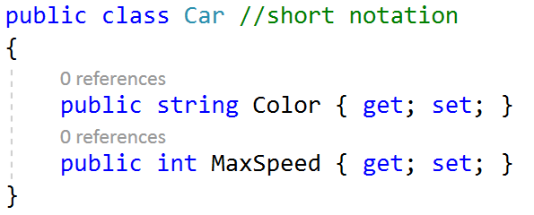
Class
C#
Java

Slide 15
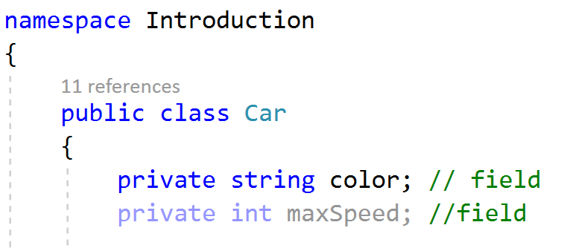
Namespace
Declares a scope that contains a set of related objects
Car class lives in Introduction namespace
In Java?

Slide 16
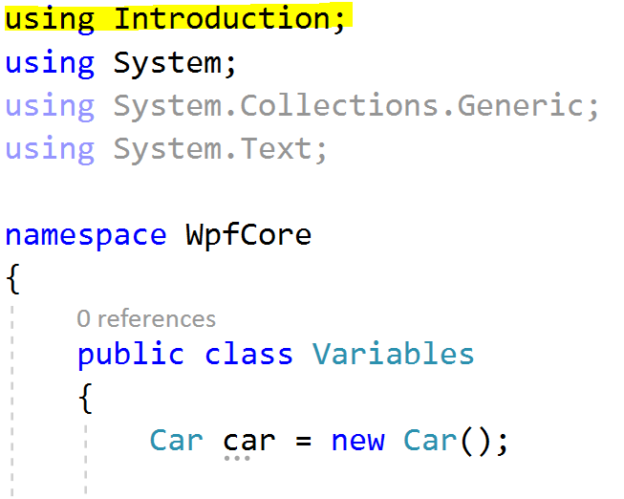
Namespace
Use Car class in other class with different namespace
In Java?

Slide 17
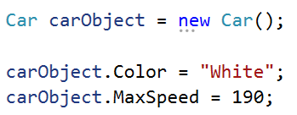
Object (instance of a class)
We want to work with a white car with a maximum speed of 190km/h
We create an instance of the Car class (carObject) and set the values through the properties:

Slide 18
Object initializers
Object initializers allow you to assign values to the properties at the time of creating an object without invoking a constructor.
Car newCar1 = new Car {Color = "Blue", MaxSpeed = 220}; Car newCar2 = new Car {Color = "Green", MaxSpeed = 240}; Car newCar3 = new Car {Color = "Gray", MaxSpeed = 180};

Slide 19
OOP: What are the three major pillars?
Encapsulation
Inheritance
Polymorphism

Slide 20
OOP: Encapsulation
Hide unnecessary implementation details
Data protection
Make “sensitive” data hidden from users
Business logic for a property can be applied in the setter

Slide 21
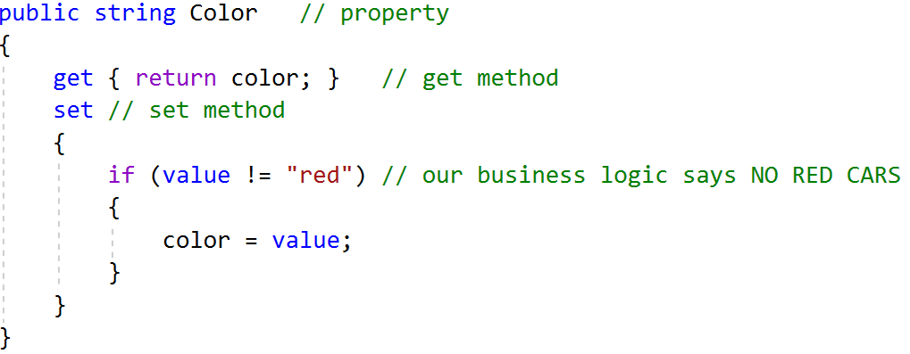
Encapsulation

Slide 22
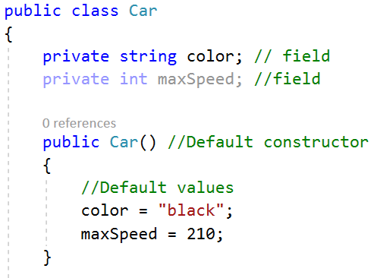
Constructor
Default constructor
No parameters
Set default values

Slide 23
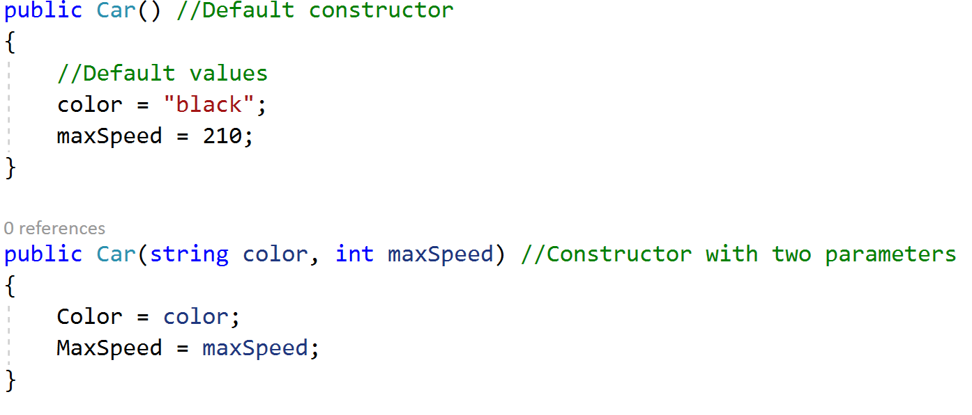
Custom constructor
Constructor with parameters
Easy to pass in values so properties are immediately set
Assign parameter value to property
Why?

Slide 24
Create an object
We can use any constructor to create an instance of the class
firstCar & secondCar are objects or instances of the Car class
How does C# know what constructor to execute?
What's the color of firstCard?
Car firstCar = new Car(); Car secondCar = new Car("Blue", 190);

Slide 25
Access Modifiers
Keywords to define which aspects of a type are visible to various parts of your application
What keywords? What do they mean?
Used with
Types => classes, interfaces, structures, enumerations and delegates
Members => properties, methods, constructors and fields

Slide 26
Access Modifiers
Access Modifier | May be applied to | Meaning
public | Types Type members | Public items can be accessed at all times by any type or member
private | Type members Nested types | Private items can only be accessed by the class (or structure) that defines the item
protected | Type members Nested types | Protected items can be used by the class which defines it, and any child class.
internal | Types Type members | Internal items are accessible only within the current assembly (.dll)
protected internal | Type members Nested types | The item is accessible within the defining assembly, the defining class, and by derived classes

Slide 27
Access Modifiers
Class Car: public
Fields color and maxSpeed: private
Properties Color and MaxSpeed: public

Slide 28
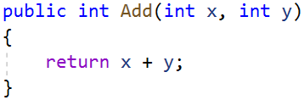
Methods
Code blocks defined in classes
Signature:
Access modifier – return type – name – parameters
Can we have multiple methods with the same name?

Slide 29
Method ToString()
Every class in C# implicitly inherits the Object class. Therefore, every object in C# gets the ToString() method, which returns a string representation of that object
You can easily change the existing ToString() method with the override keyword
public override string ToString() { return "Person: " + Name + " " + Age; }

Slide 30
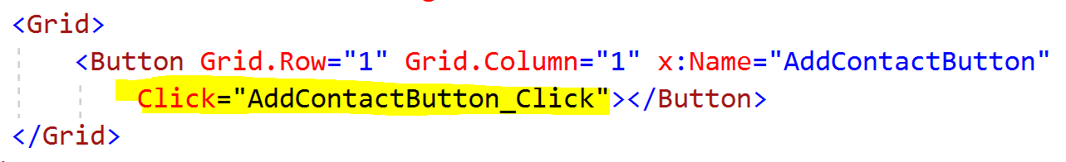
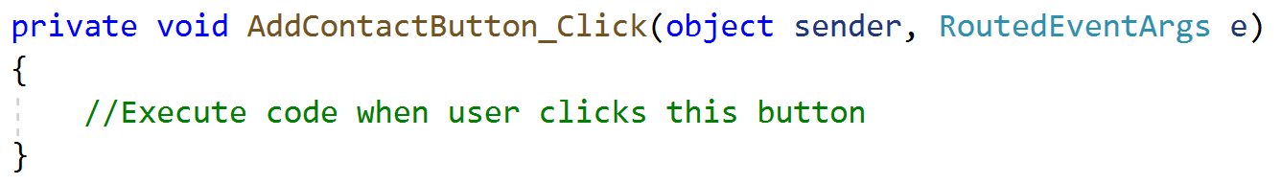
Events
Code that needs to be executed when something happens (mostly user interactions)
Events always have two parameters.
What is sender? What information in EventArgs?

Slide 31
OOP: Inheritance
Build a new class based on an existing class definition
Extend behavior of a base (parent, super) class by inheriting core functionality into the derived subclass (child)
is a relationship
A rectangle is a shape
A dog is an animal
Code reusability

Slide 32
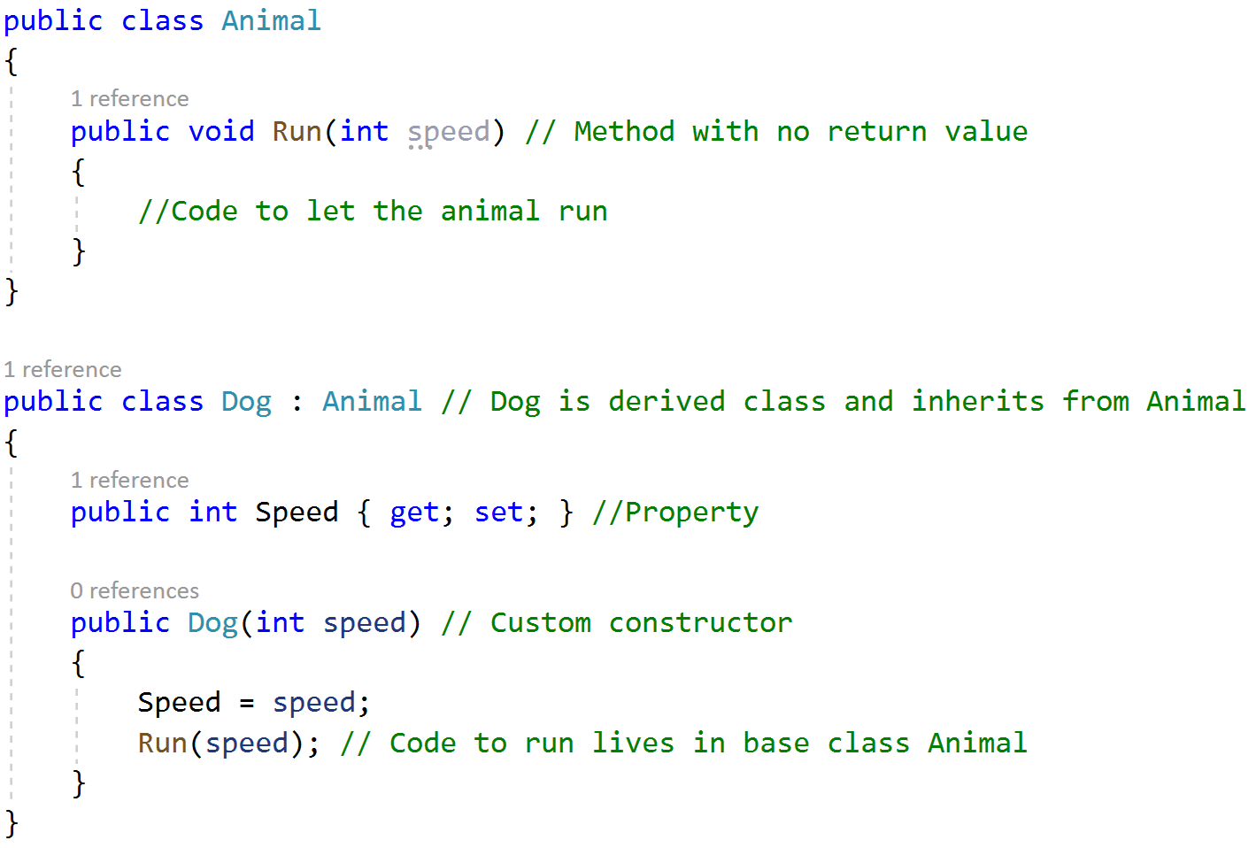
Inheritance

Slide 33
OOP: Polymorphism
Treat related objects in a similar manner
Base class defines a set of members that are available to all descendants
Virtual members
Define a default implementation that may be changed (overridden) by a derived class
Abstract methods
Members in base class that have no default implementation, but only a signature, must be overridden by a derived type

Slide 34
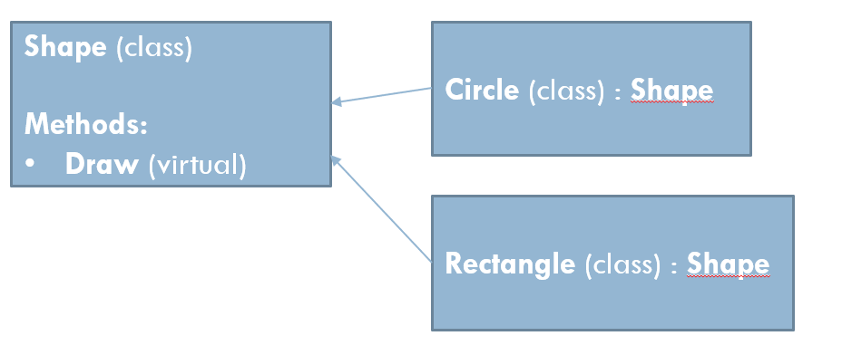
Polymorphism: virtual
Virtual method Draw in the base class
Circle and Rectangle should have the possibility to be drawn = Draw() method
They both are drawn in a different way, so they can override the method to their own liking

Slide 35
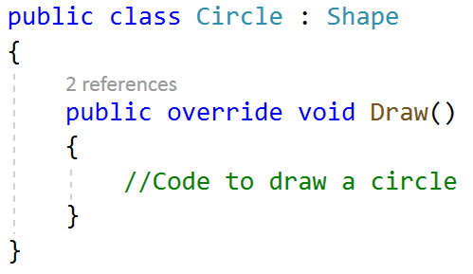
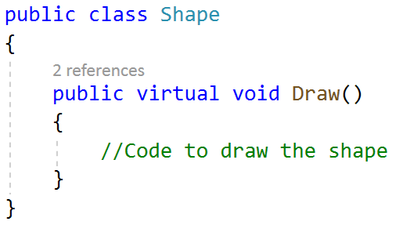
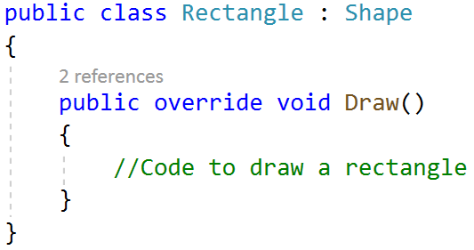
Polymorphism: virtual

Slide 36
Interface
A set of abstract members
Contract for a class
Member in interface has to be implemented in class
ICar.cs → name starts with I

Slide 37
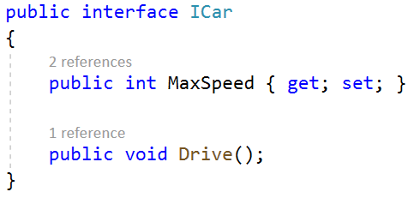
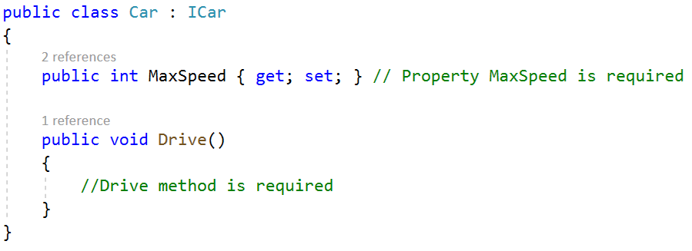
Interface

Slide 38
Time to quiz

Slide 39
Time to practice
Exercise Rentabike

